Slide 1
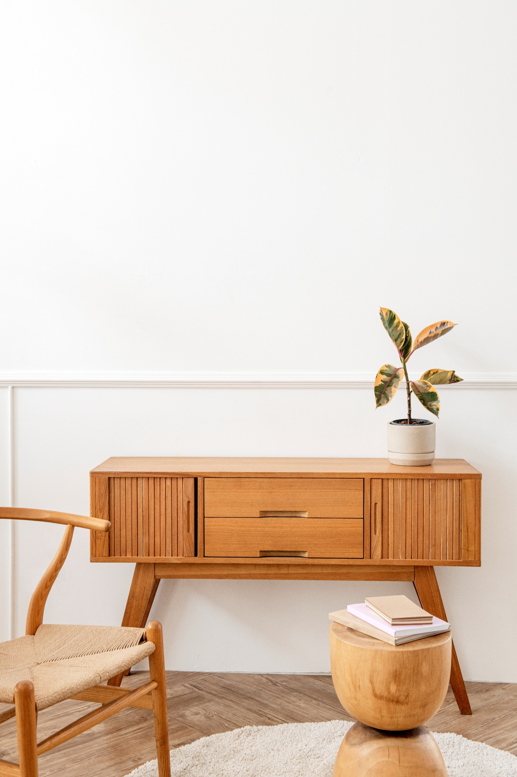

x
Solid Wood and Rattan Furniture
Custom Furniture - Home Project – Home Decoration – Interior Design & Product

Slide 2

NIKI MEBEL
We provide custom furniture according to your needs.

Slide 3
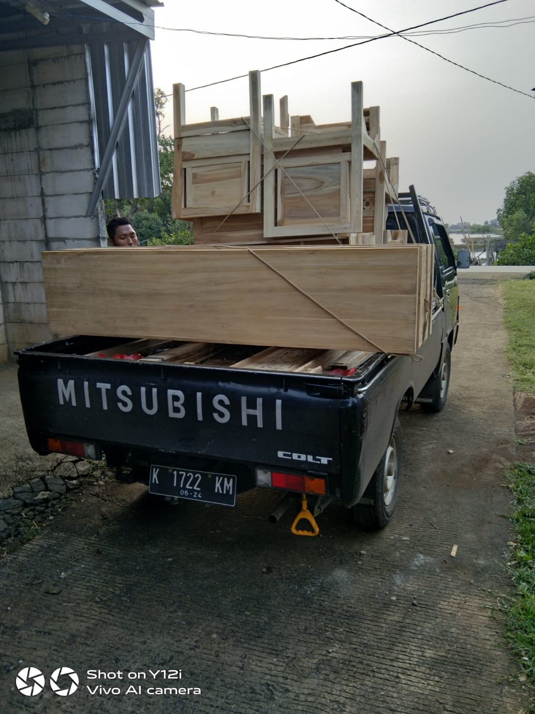
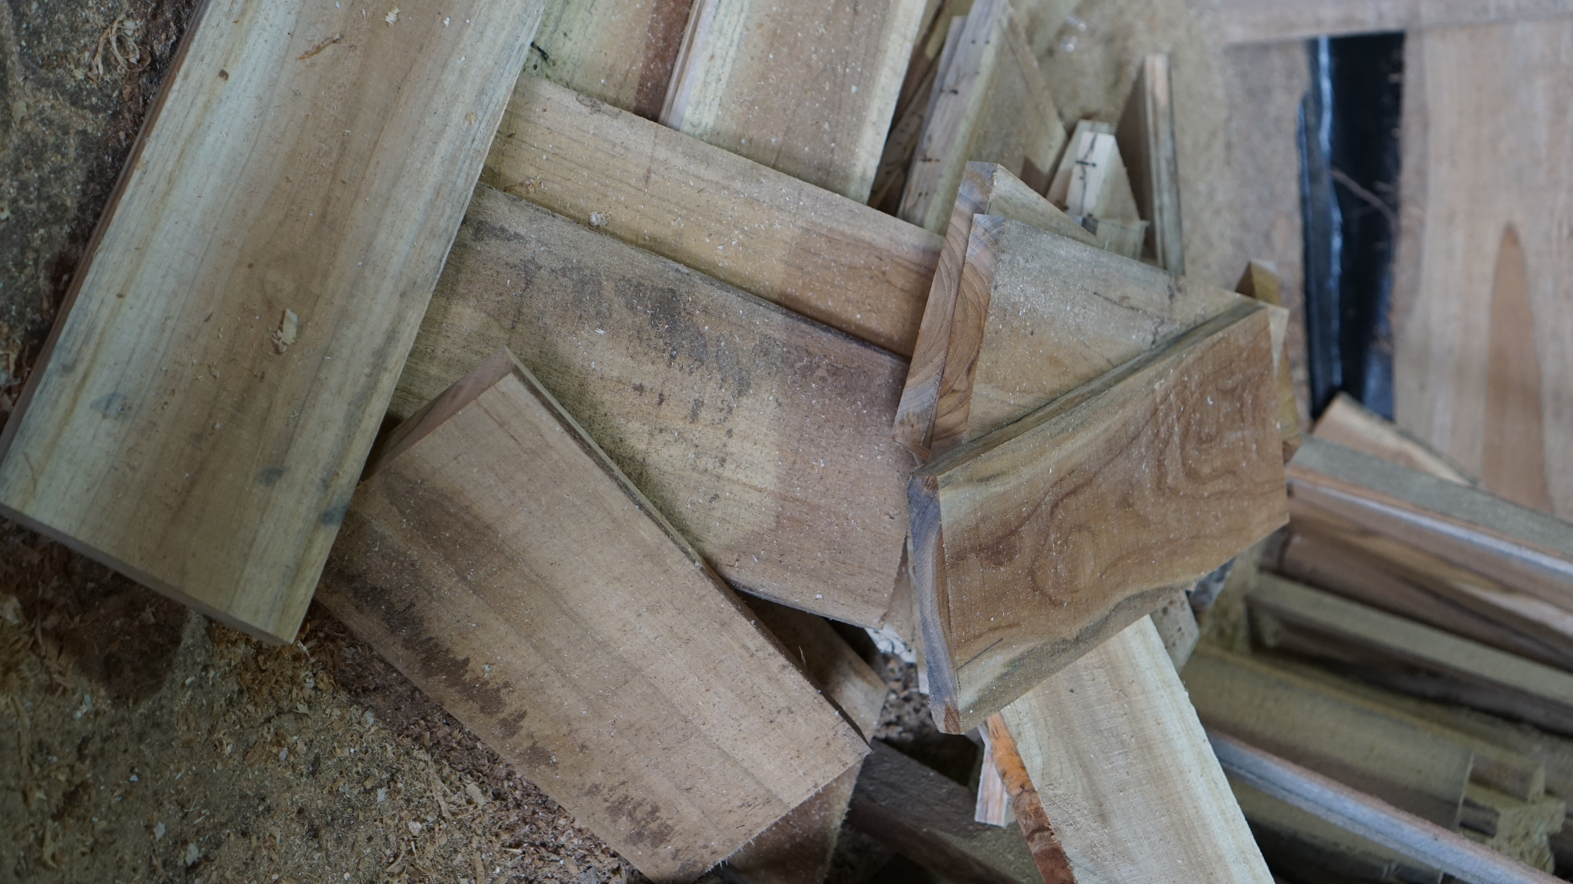
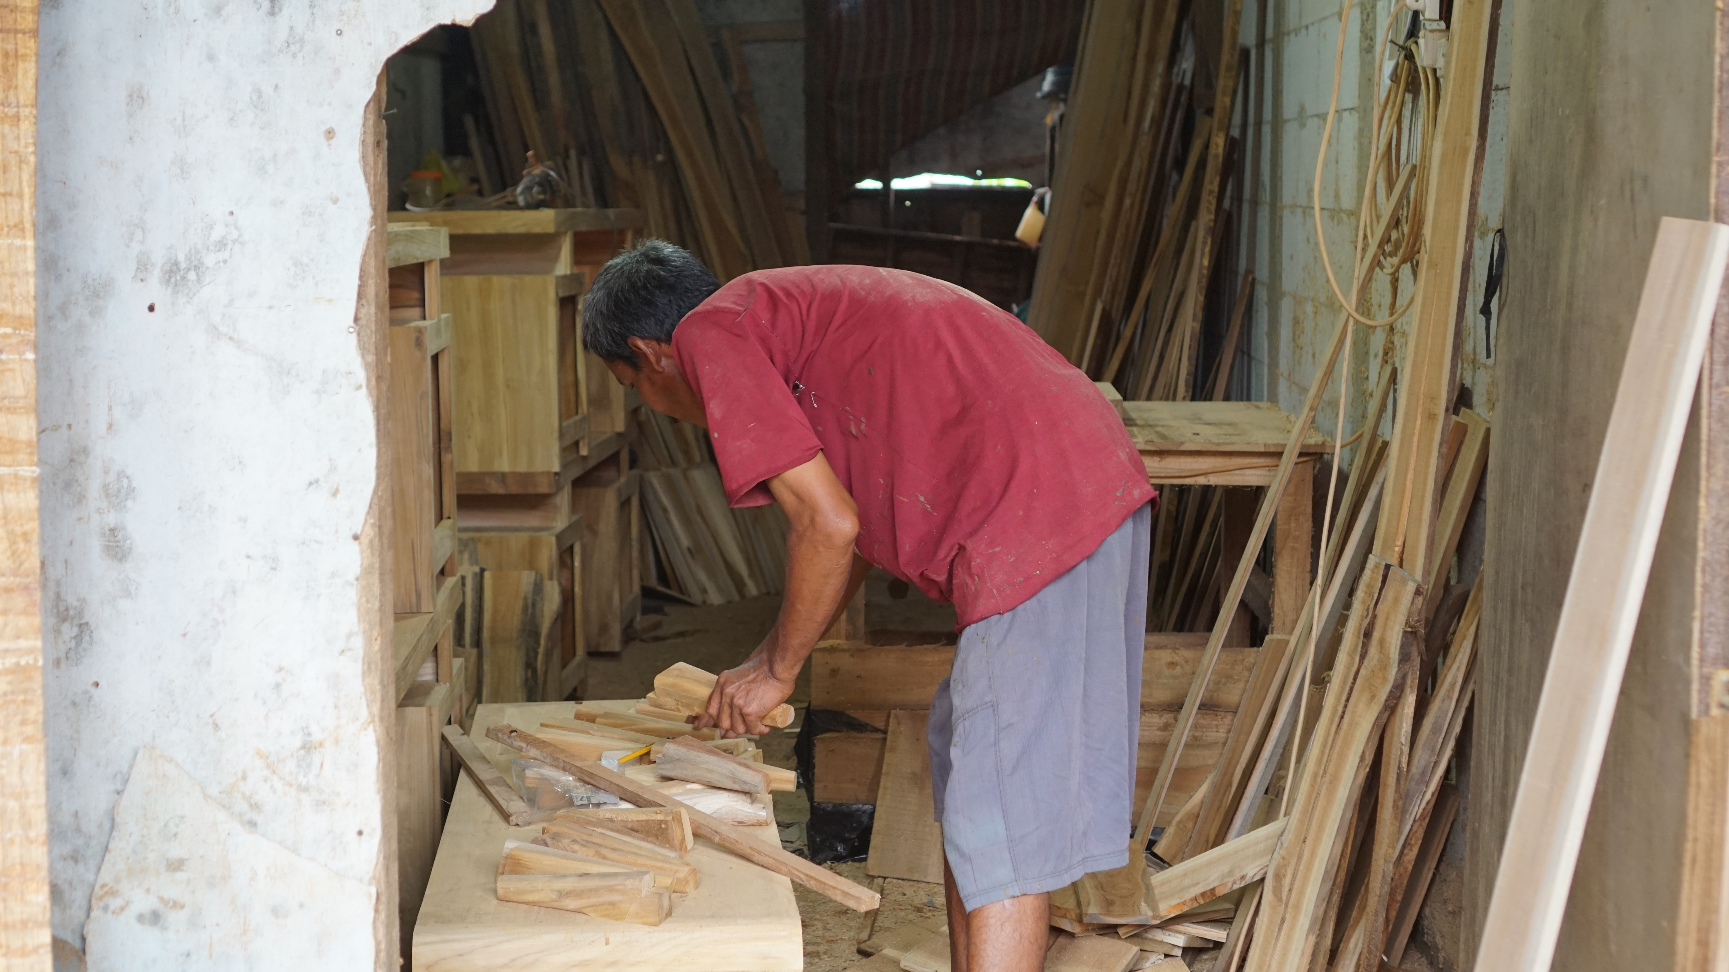
NIKI MEBEL

Slide 4
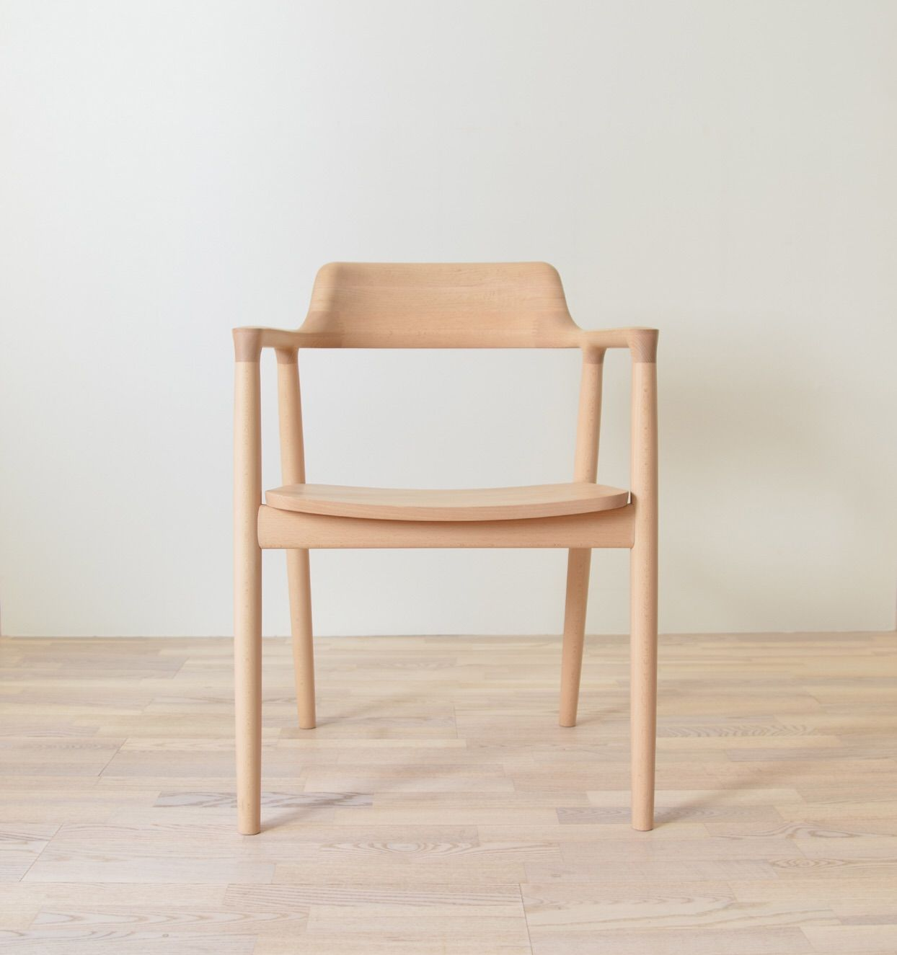
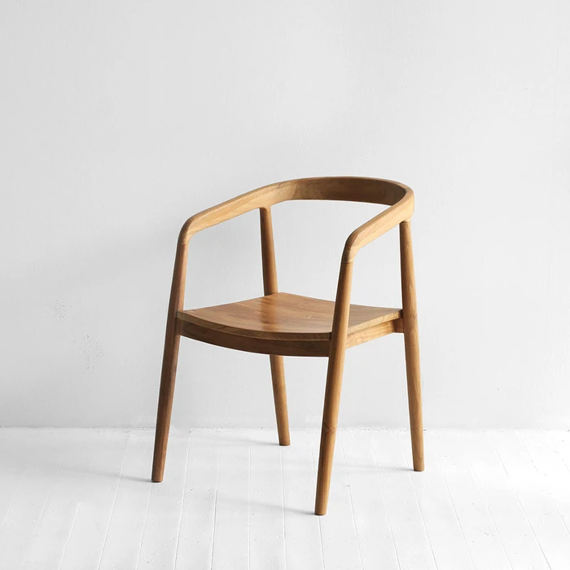
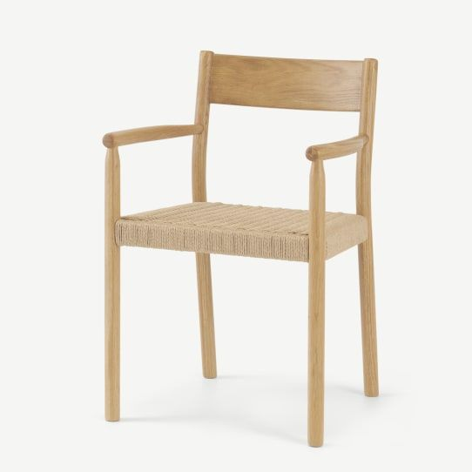
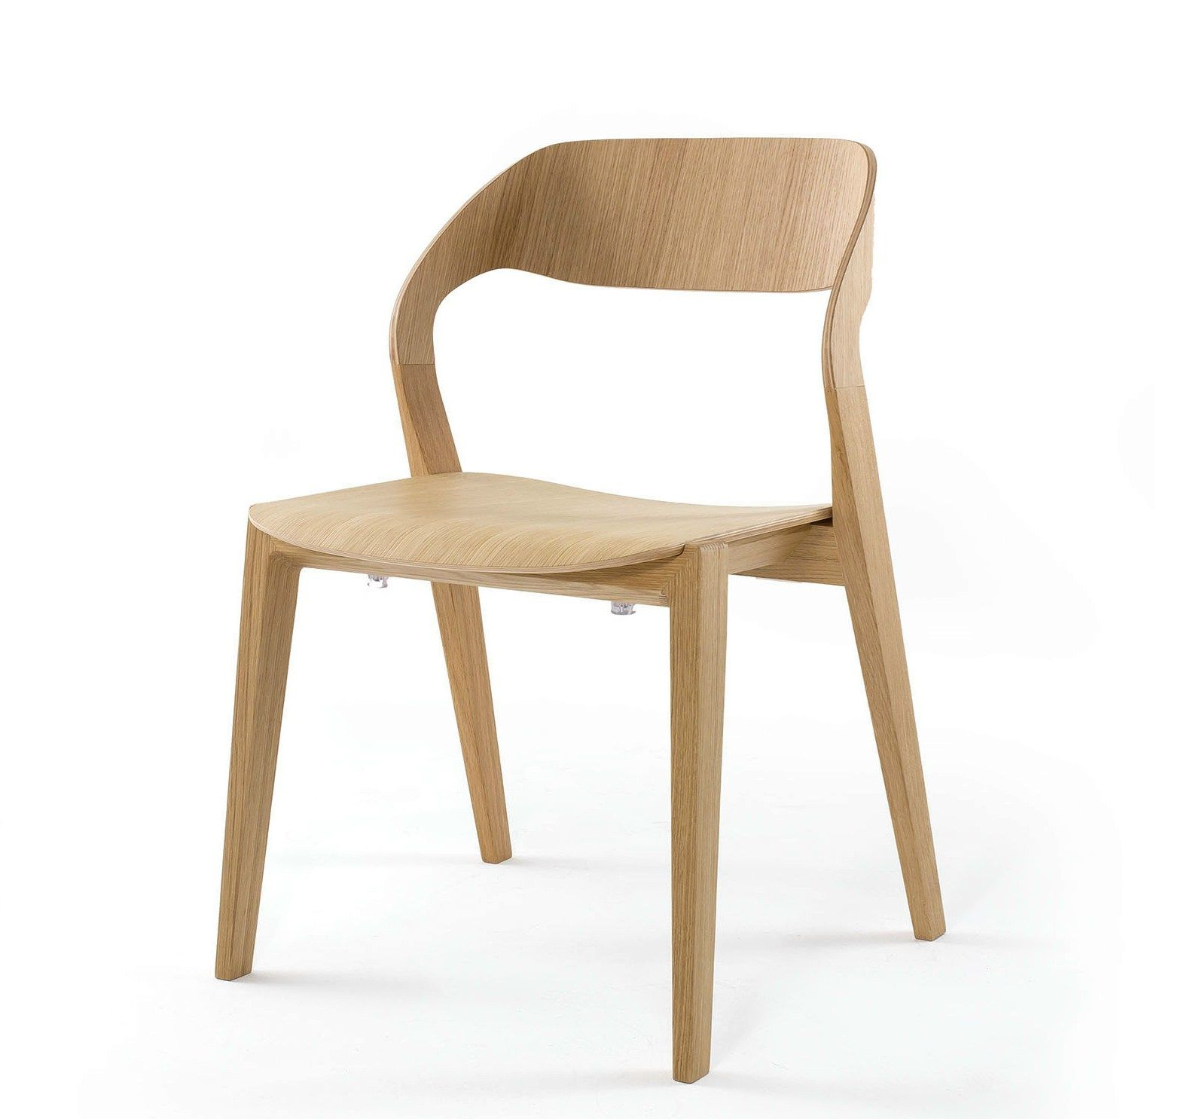
Dining Chair
Niki Mebel
Hirosima Chair
IDR 700.000 / 4-10 item
IDR 650.000 / 10-20 item
IDR 600.000 / >20 item
Tambahan Foam Charged IDR 100.000
Esely Chair
IDR 650.000 / 4-10 item
IDR 600.000 / 10-20 item
IDR 550.000 / >20 item
Tambahan Foam Charged IDR 100.000
Rubi Chair
IDR 800.000 / 4-10 item
IDR 750.000 / 10-20 item
IDR 700.000 / >20 item
Tambahan Foam Charged IDR 100.000
Toza Chair
IDR 750.000 / 4-10 item
IDR 700.000 / 10-20 item
IDR 650.000 / >20 item
Tambahan Foam Charged IDR 100.000
Ready Custom For You

Slide 5
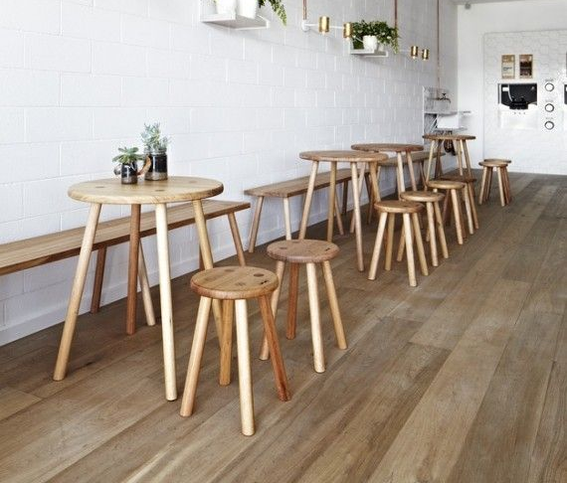
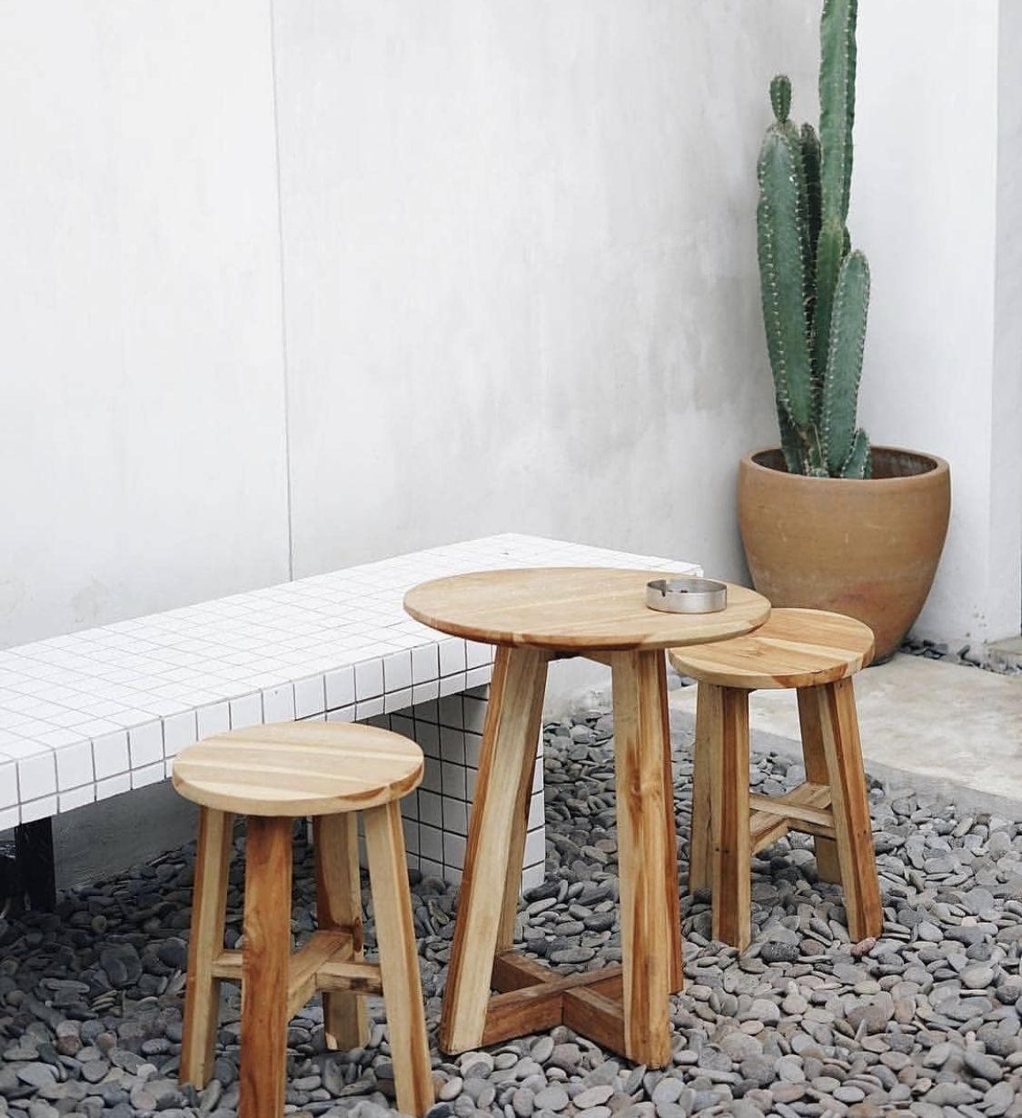
Project Coffee Shop

Slide 6
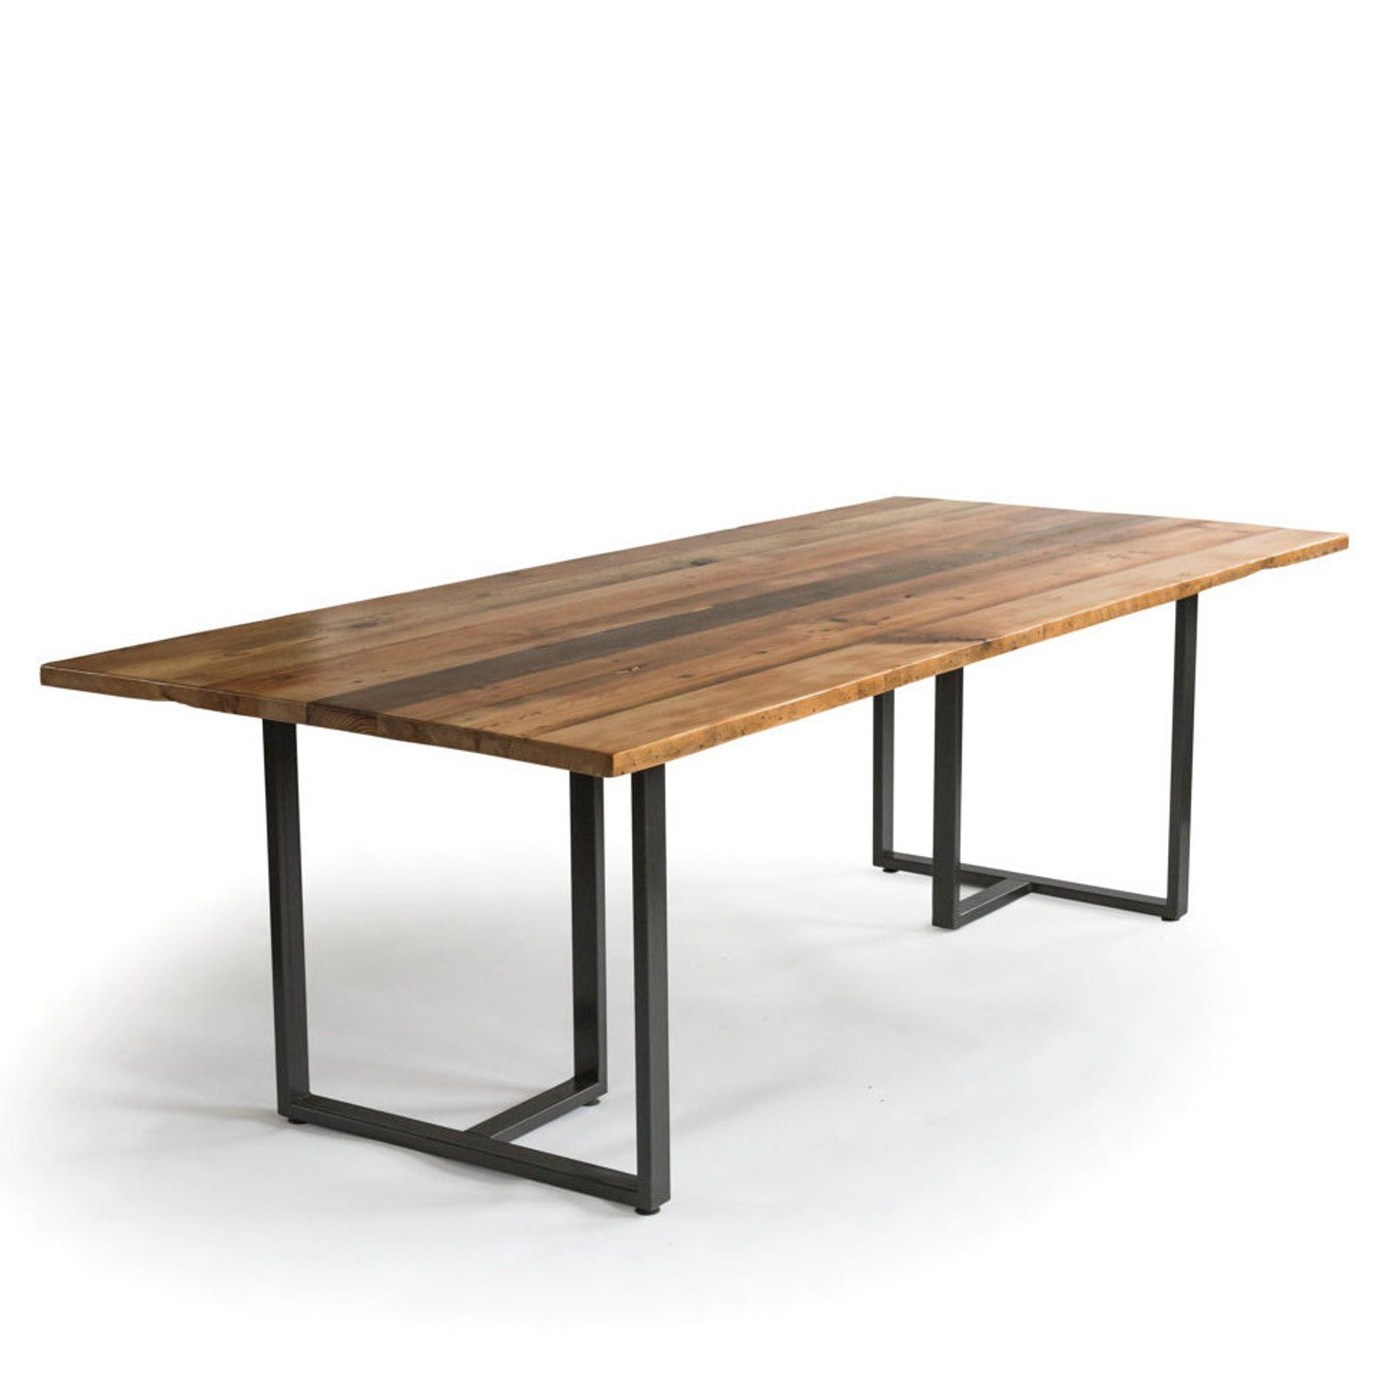
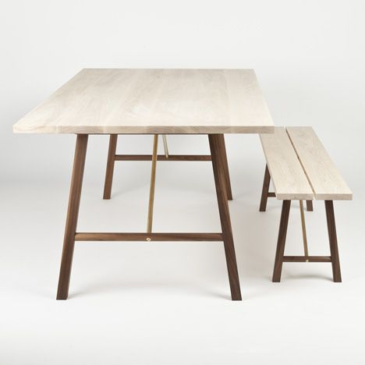
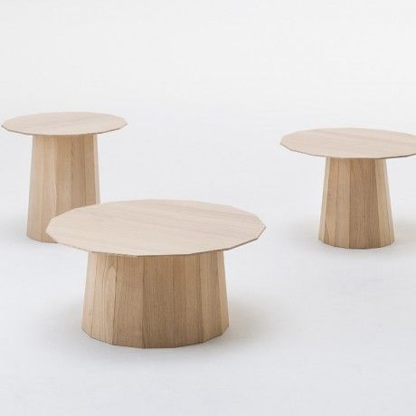
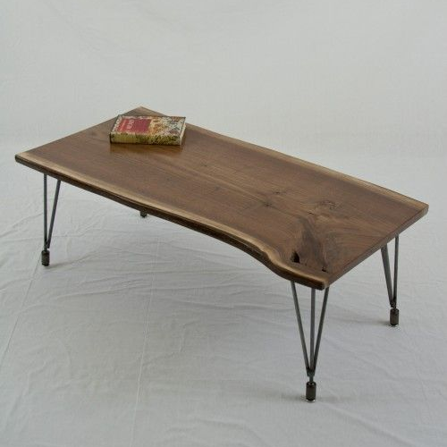
Dining Table
Niki Mebel
Universal Chair
Cafe Table
Moon Table
Natural Table
Ready Custom For You

Slide 7
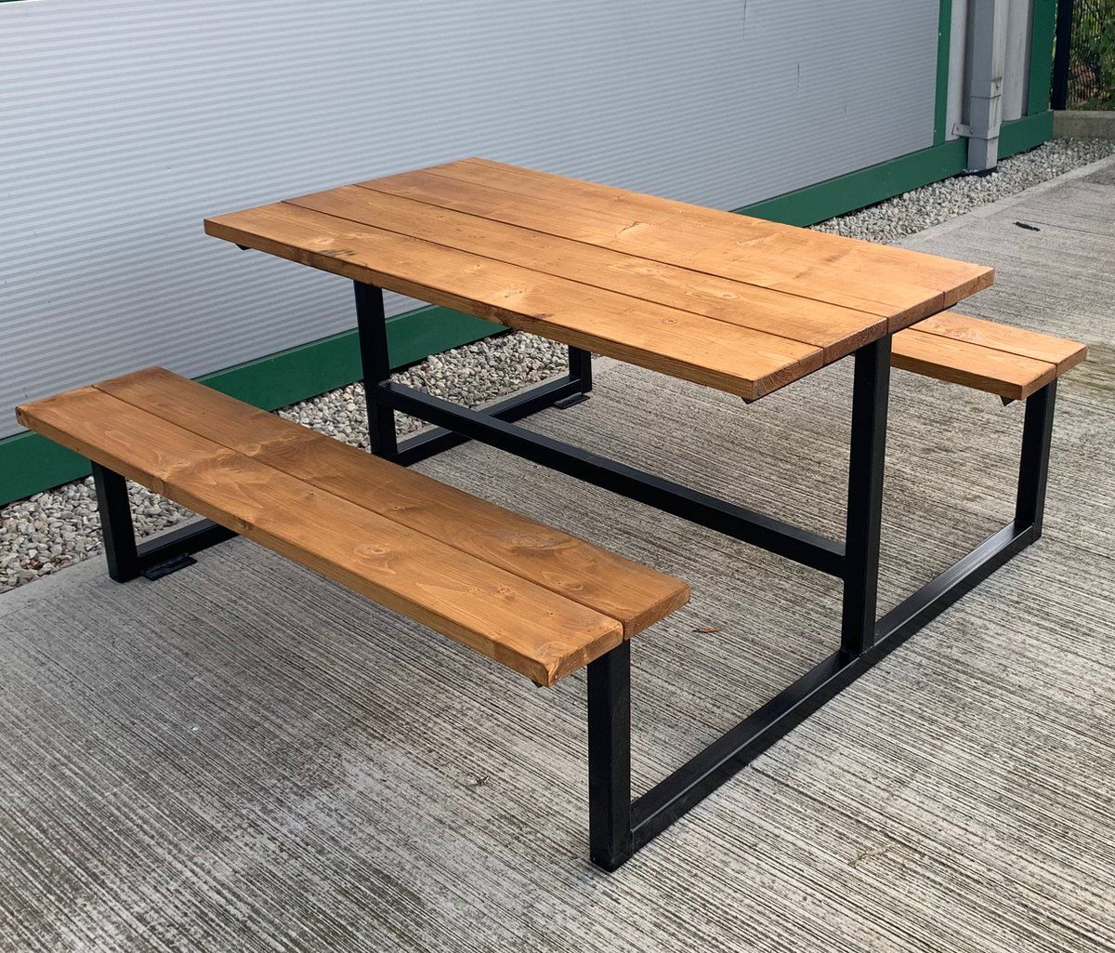

Project Restoran

Slide 8
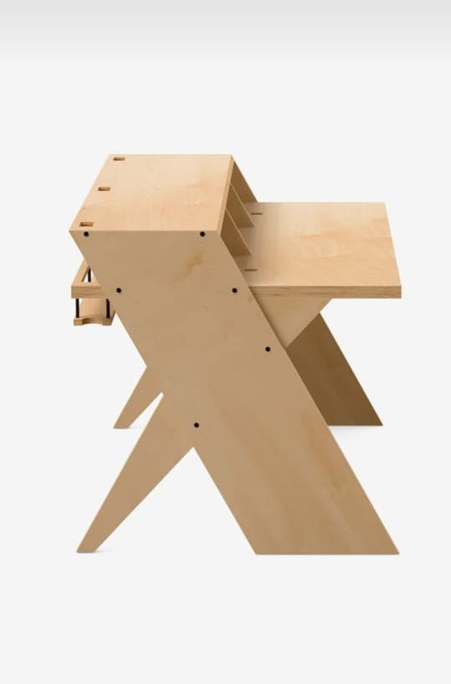
Project Office

Slide 9
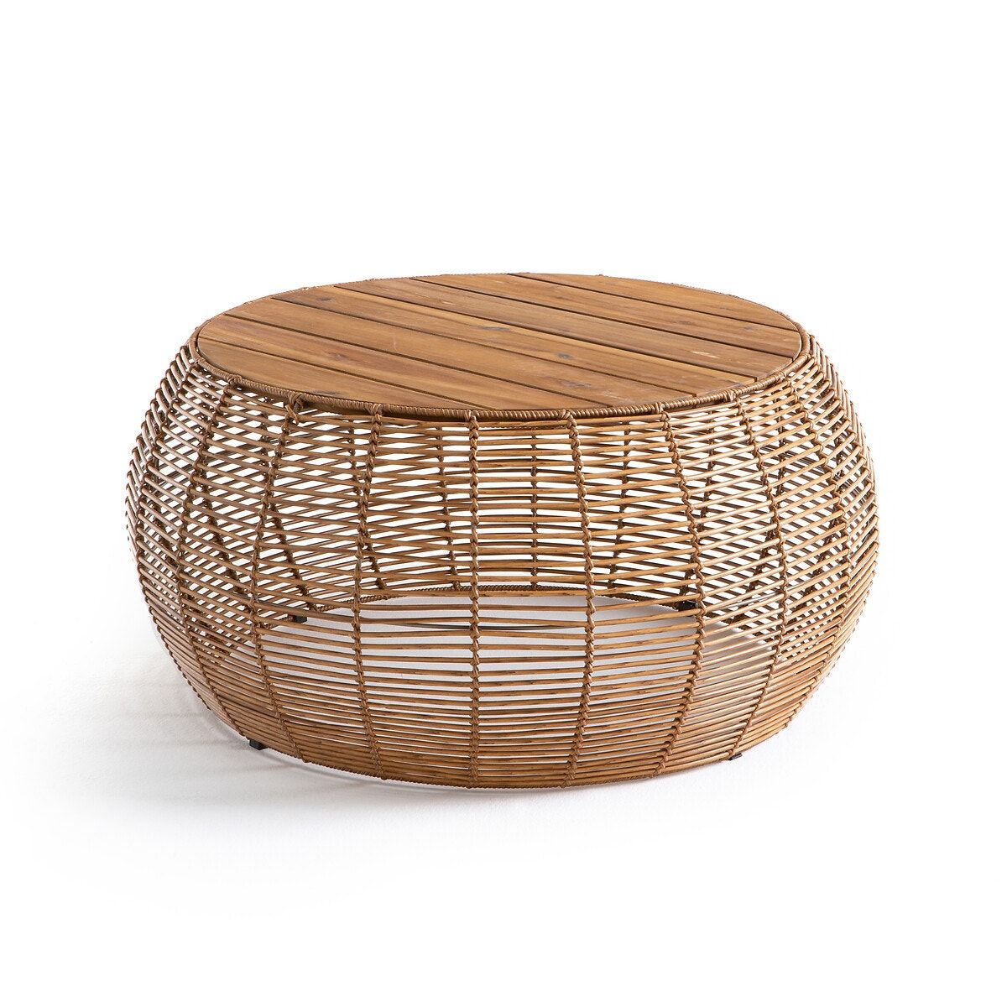

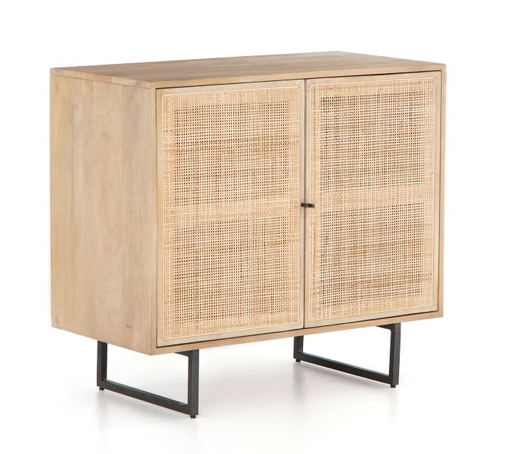
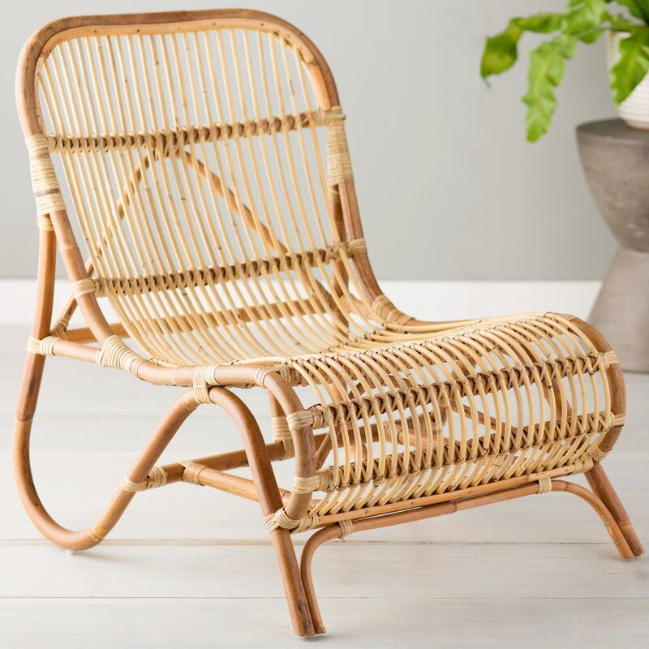
Rattan Furniture
Niki Mebel
Tabel
Decoration
Cabinet
xxxx
Chair
xxxx
Ready Custom For You

Slide 10
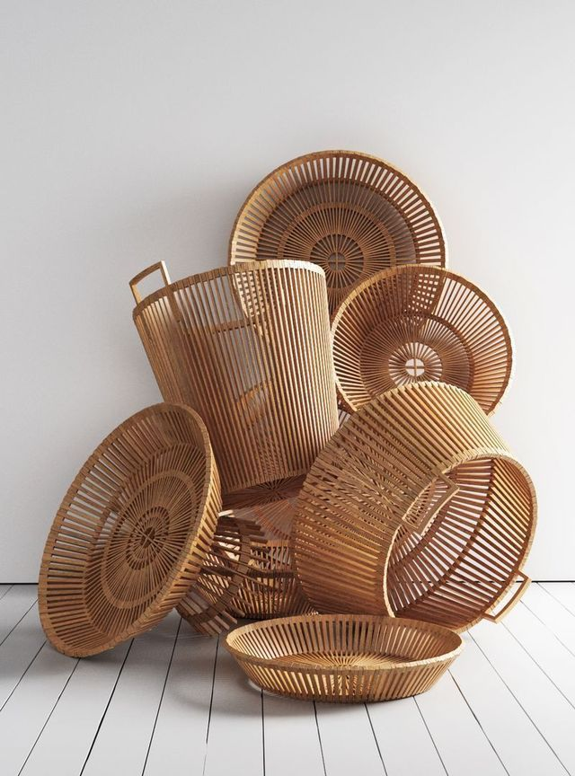
Project Rattan

Slide 11




Niki Mebel
PT NIKI GRUP INDONESIA
Ds. Margorejo Dk. Gentungan RT 004 RW 001 Kec. Dawe Kab. Kudus - 59353
nikimebel.com
+62 878-5565-1181
nikimebel.official

